Slide 1



Stealth Malaria: Modeling hrp2 Deletions Epidemiology Lab
Nick Brazeau
MD/PhD Candidate (PhD3)
UNC Gilling’s Epidemiology Department

Slide 2

Where in the Epi World?
Description
Prediction
Causal Inference
Regression Modeling
Un/Supervised Machine Learning
Risk Score Models
Summary Statistics
Basic 2x2 Tables
Unsupervised ML Classification Tasks
Randomized Control Trials
Regression Modeling
Inverse Probability Weights
G-formula
Mathematical Modeling
Deterministic
Stochastic
Disclaimer: IMO/Hernán
Hernán et al. 2019, DOI: 10.1080/09332480.2019.1579578
Notes:
Add what a hmm is simply

Slide 3
Purpose of this Exercise
Apply a compartment model to a “real-life” scenario (hrp2 Gene Deletion Case-Study)
Assess the effects of selection on prevalence and incidence
Gain experience working with a complex mathematical model (i.e. “The Imperial Model”) and individual-based stochastic models
Notes:
Add what a hmm is simply

Slide 4
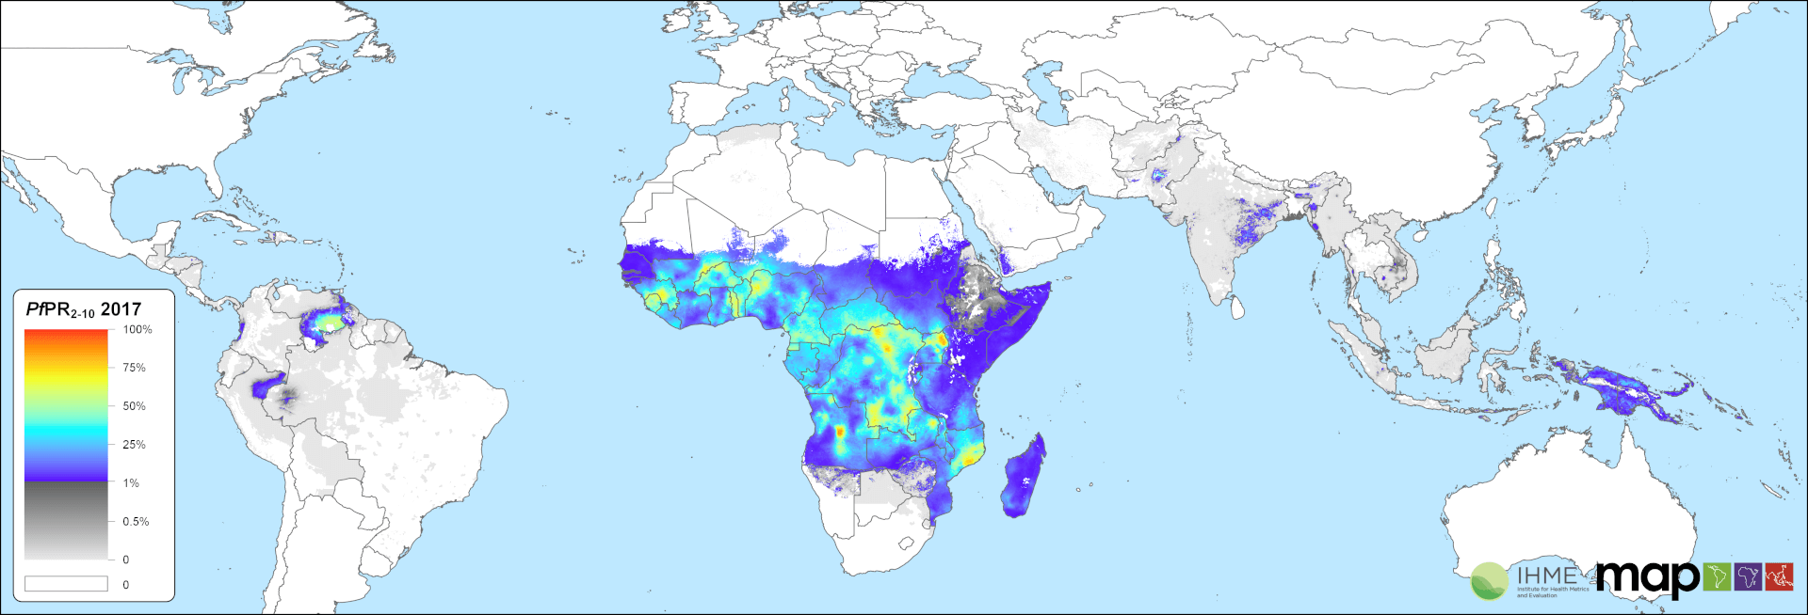
Global Burden of Malaria
Malaria is one of the “Big 3” Global Infectious Diseases
Widespread burden, concentrated in Africa
Malaria Atlas Project
Notes:
Add what a hmm is simply

Slide 5
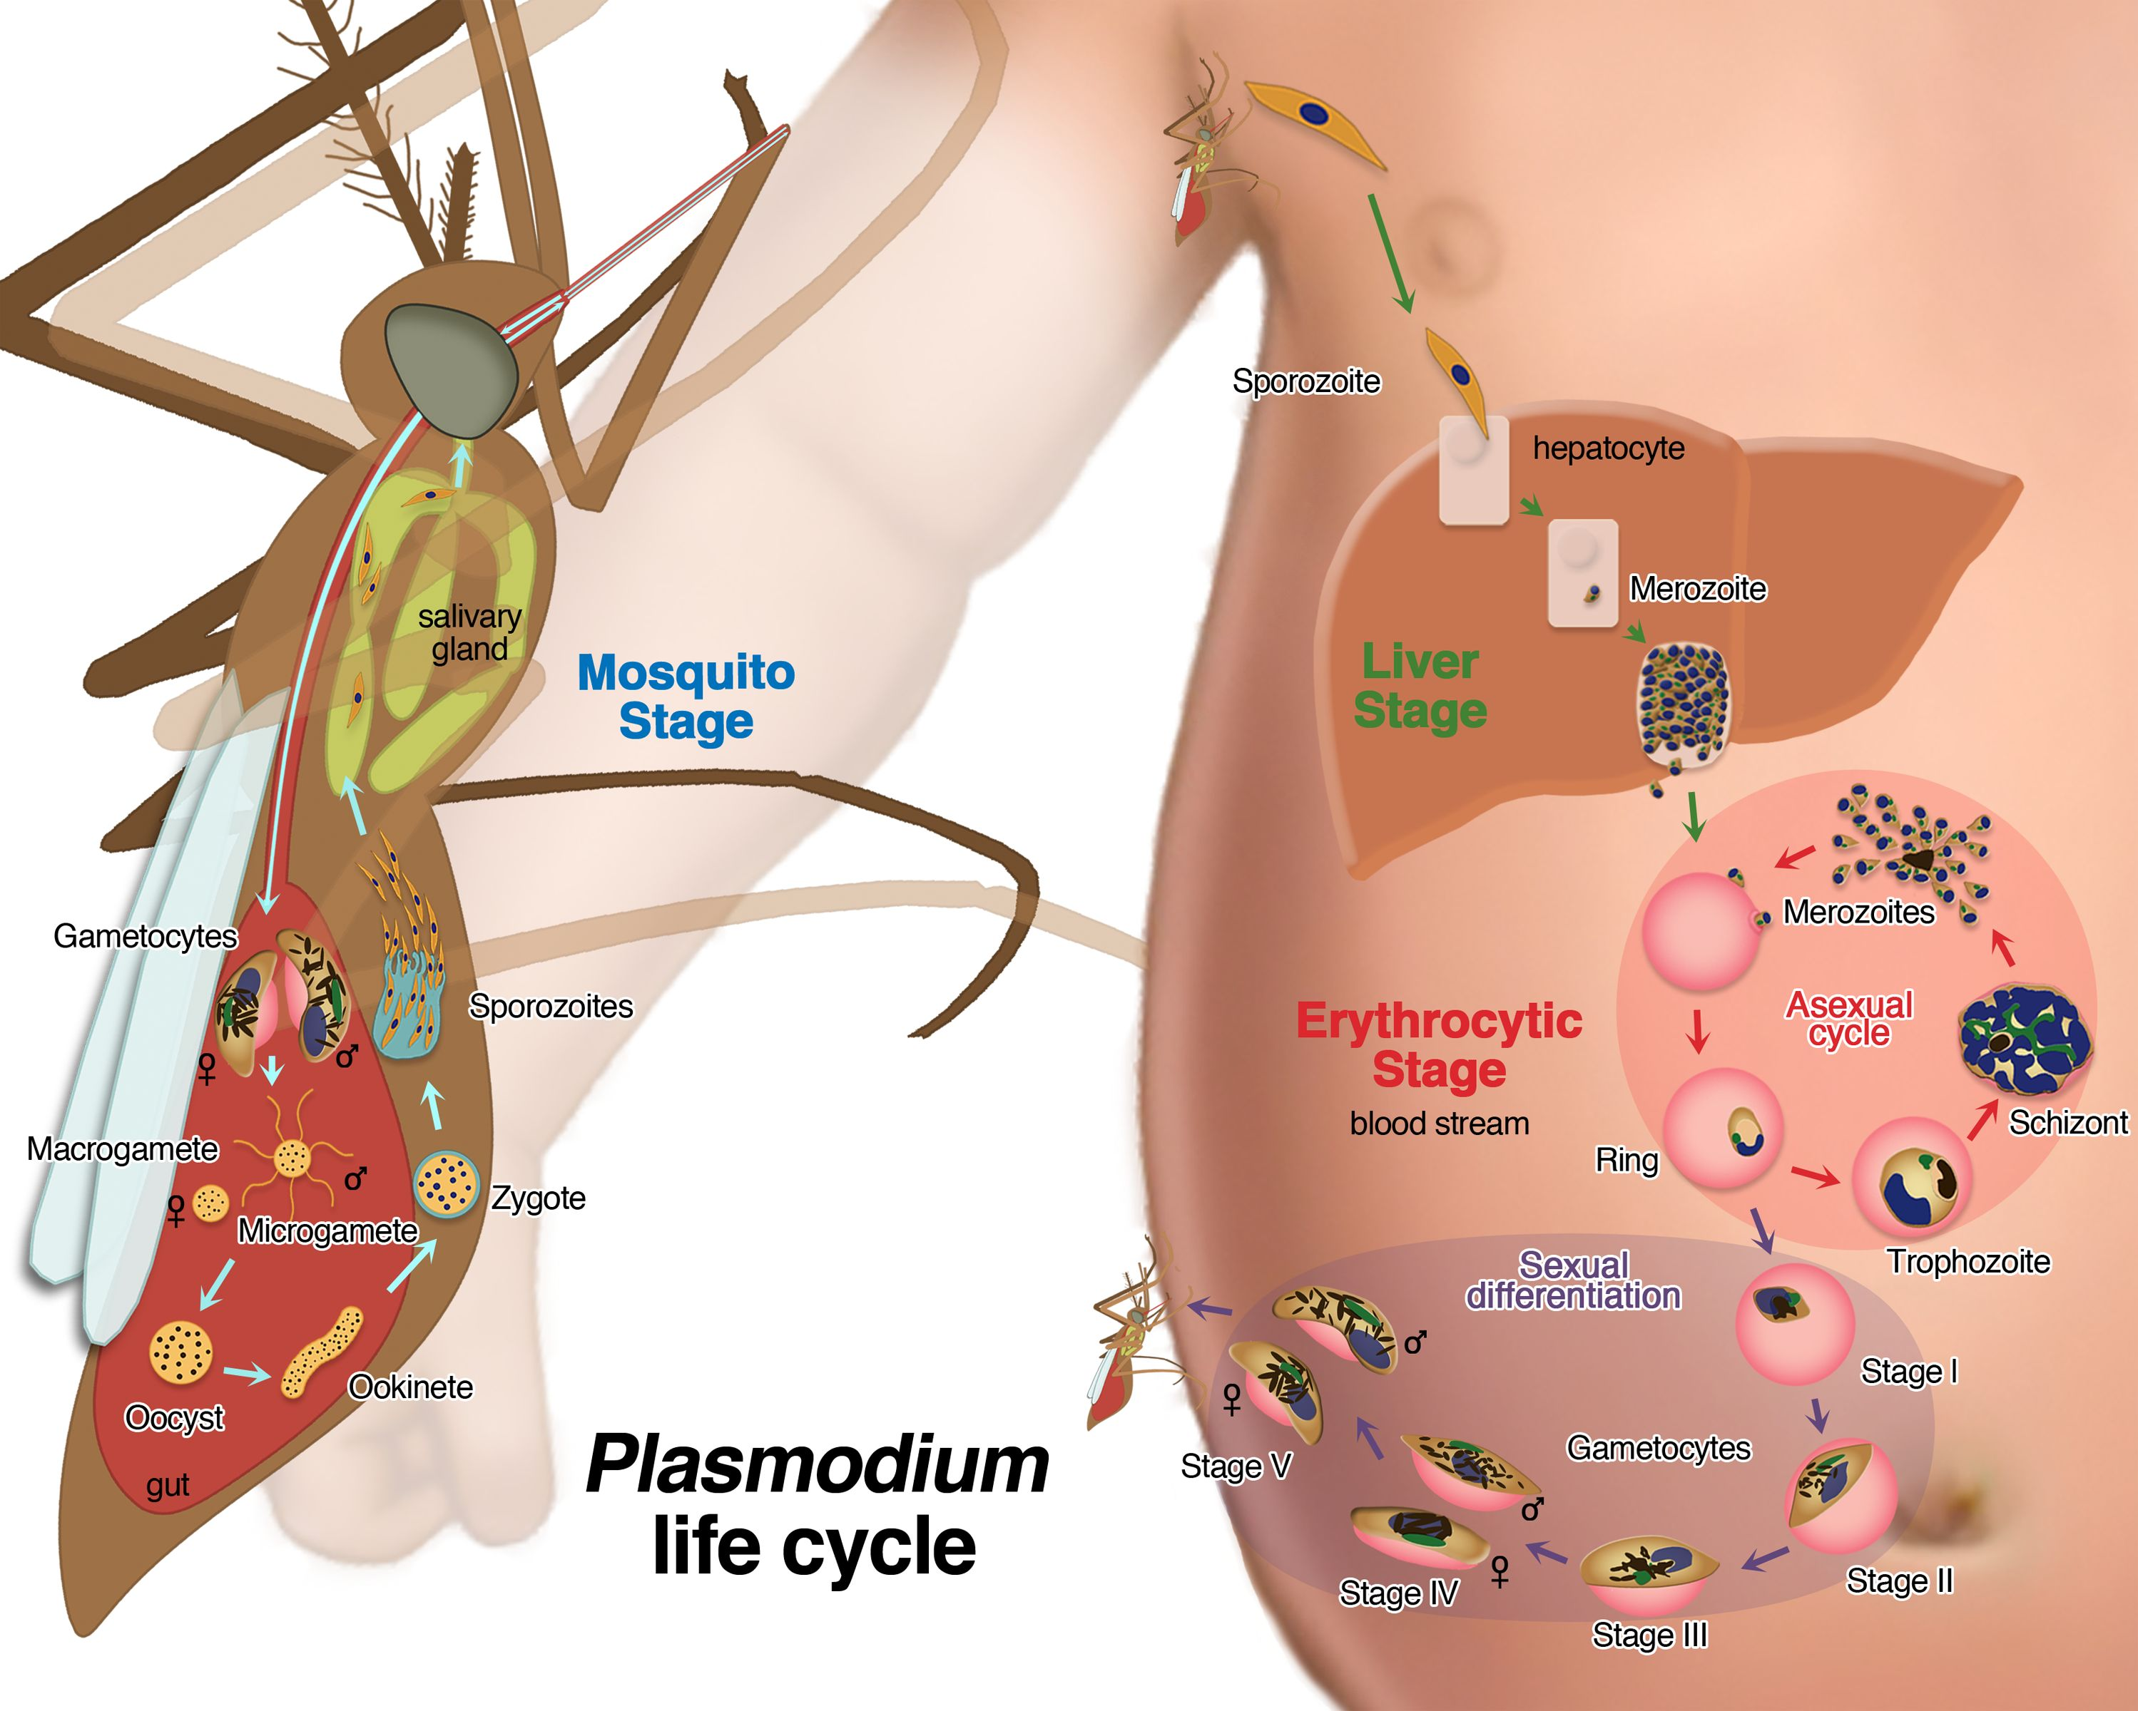
Malaria Life Cycle
Complex
Mosquito vector, human host
Notes:
Add what a hmm is simply

Slide 6
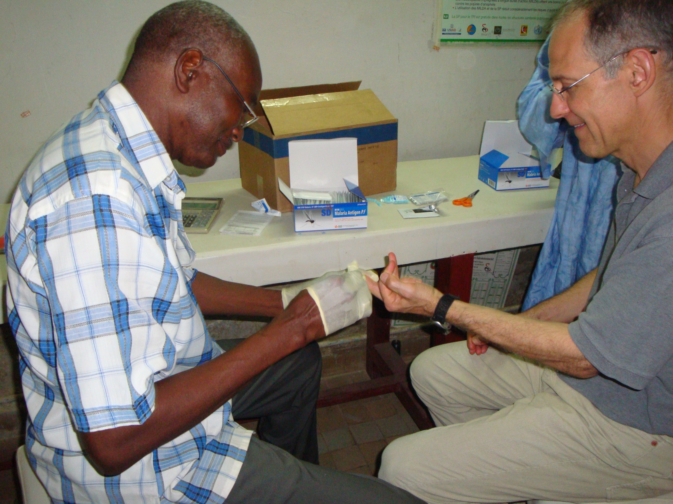
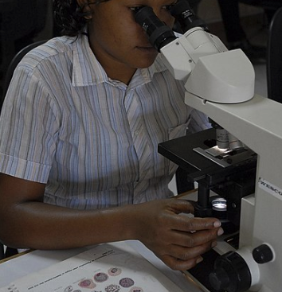
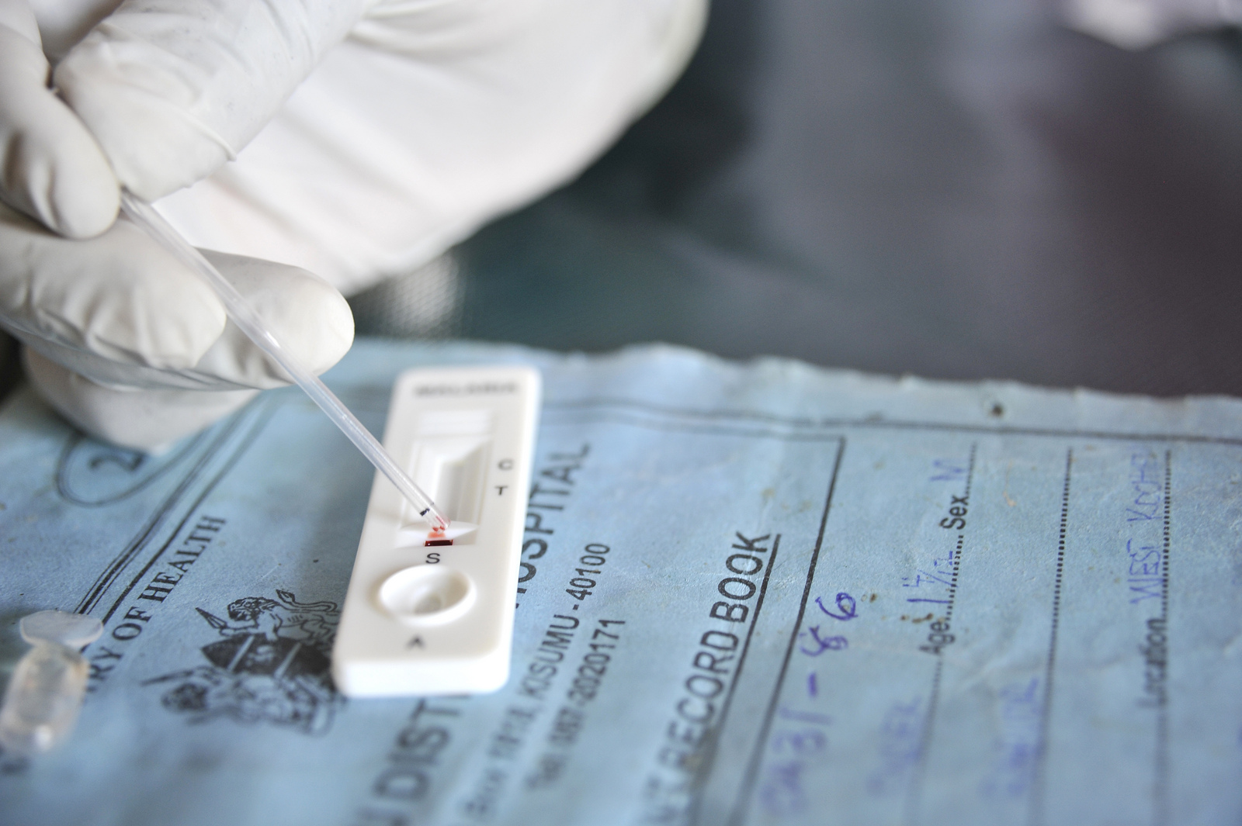
Malaria Diagnostics
Notes:
Add what a hmm is simply

Slide 7
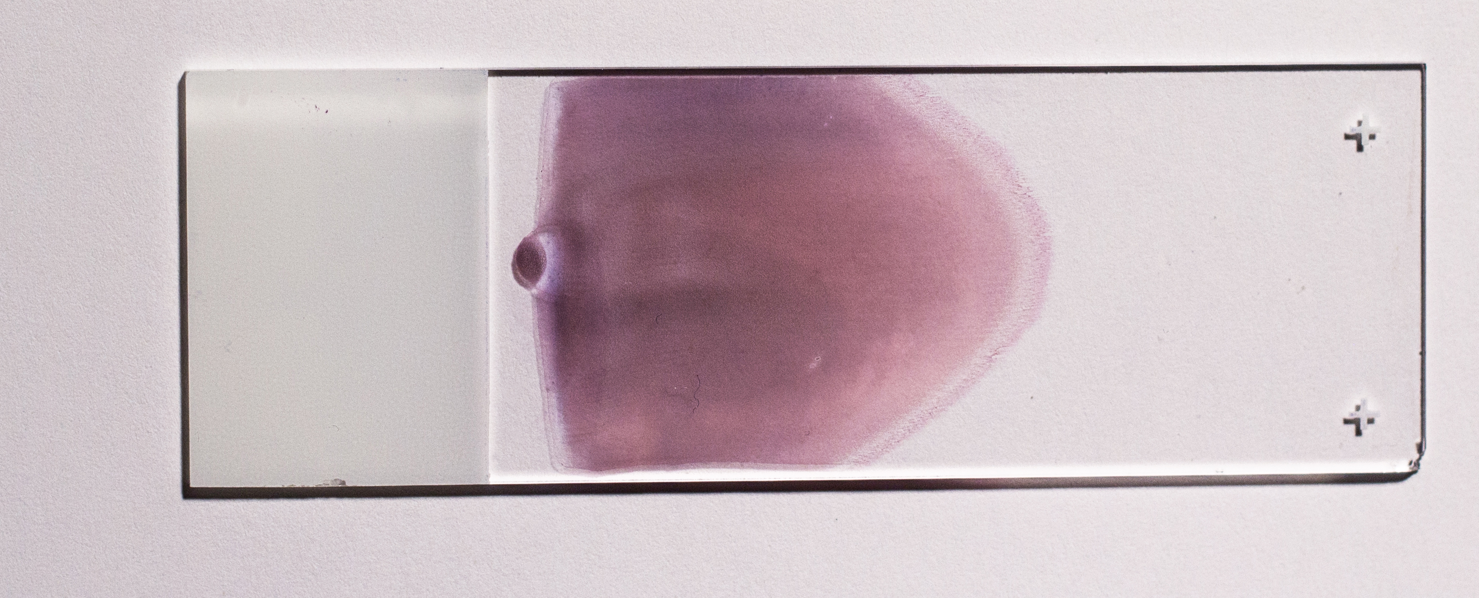
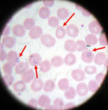
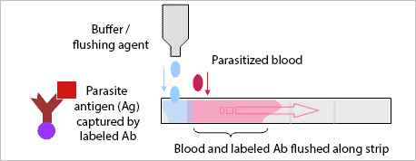
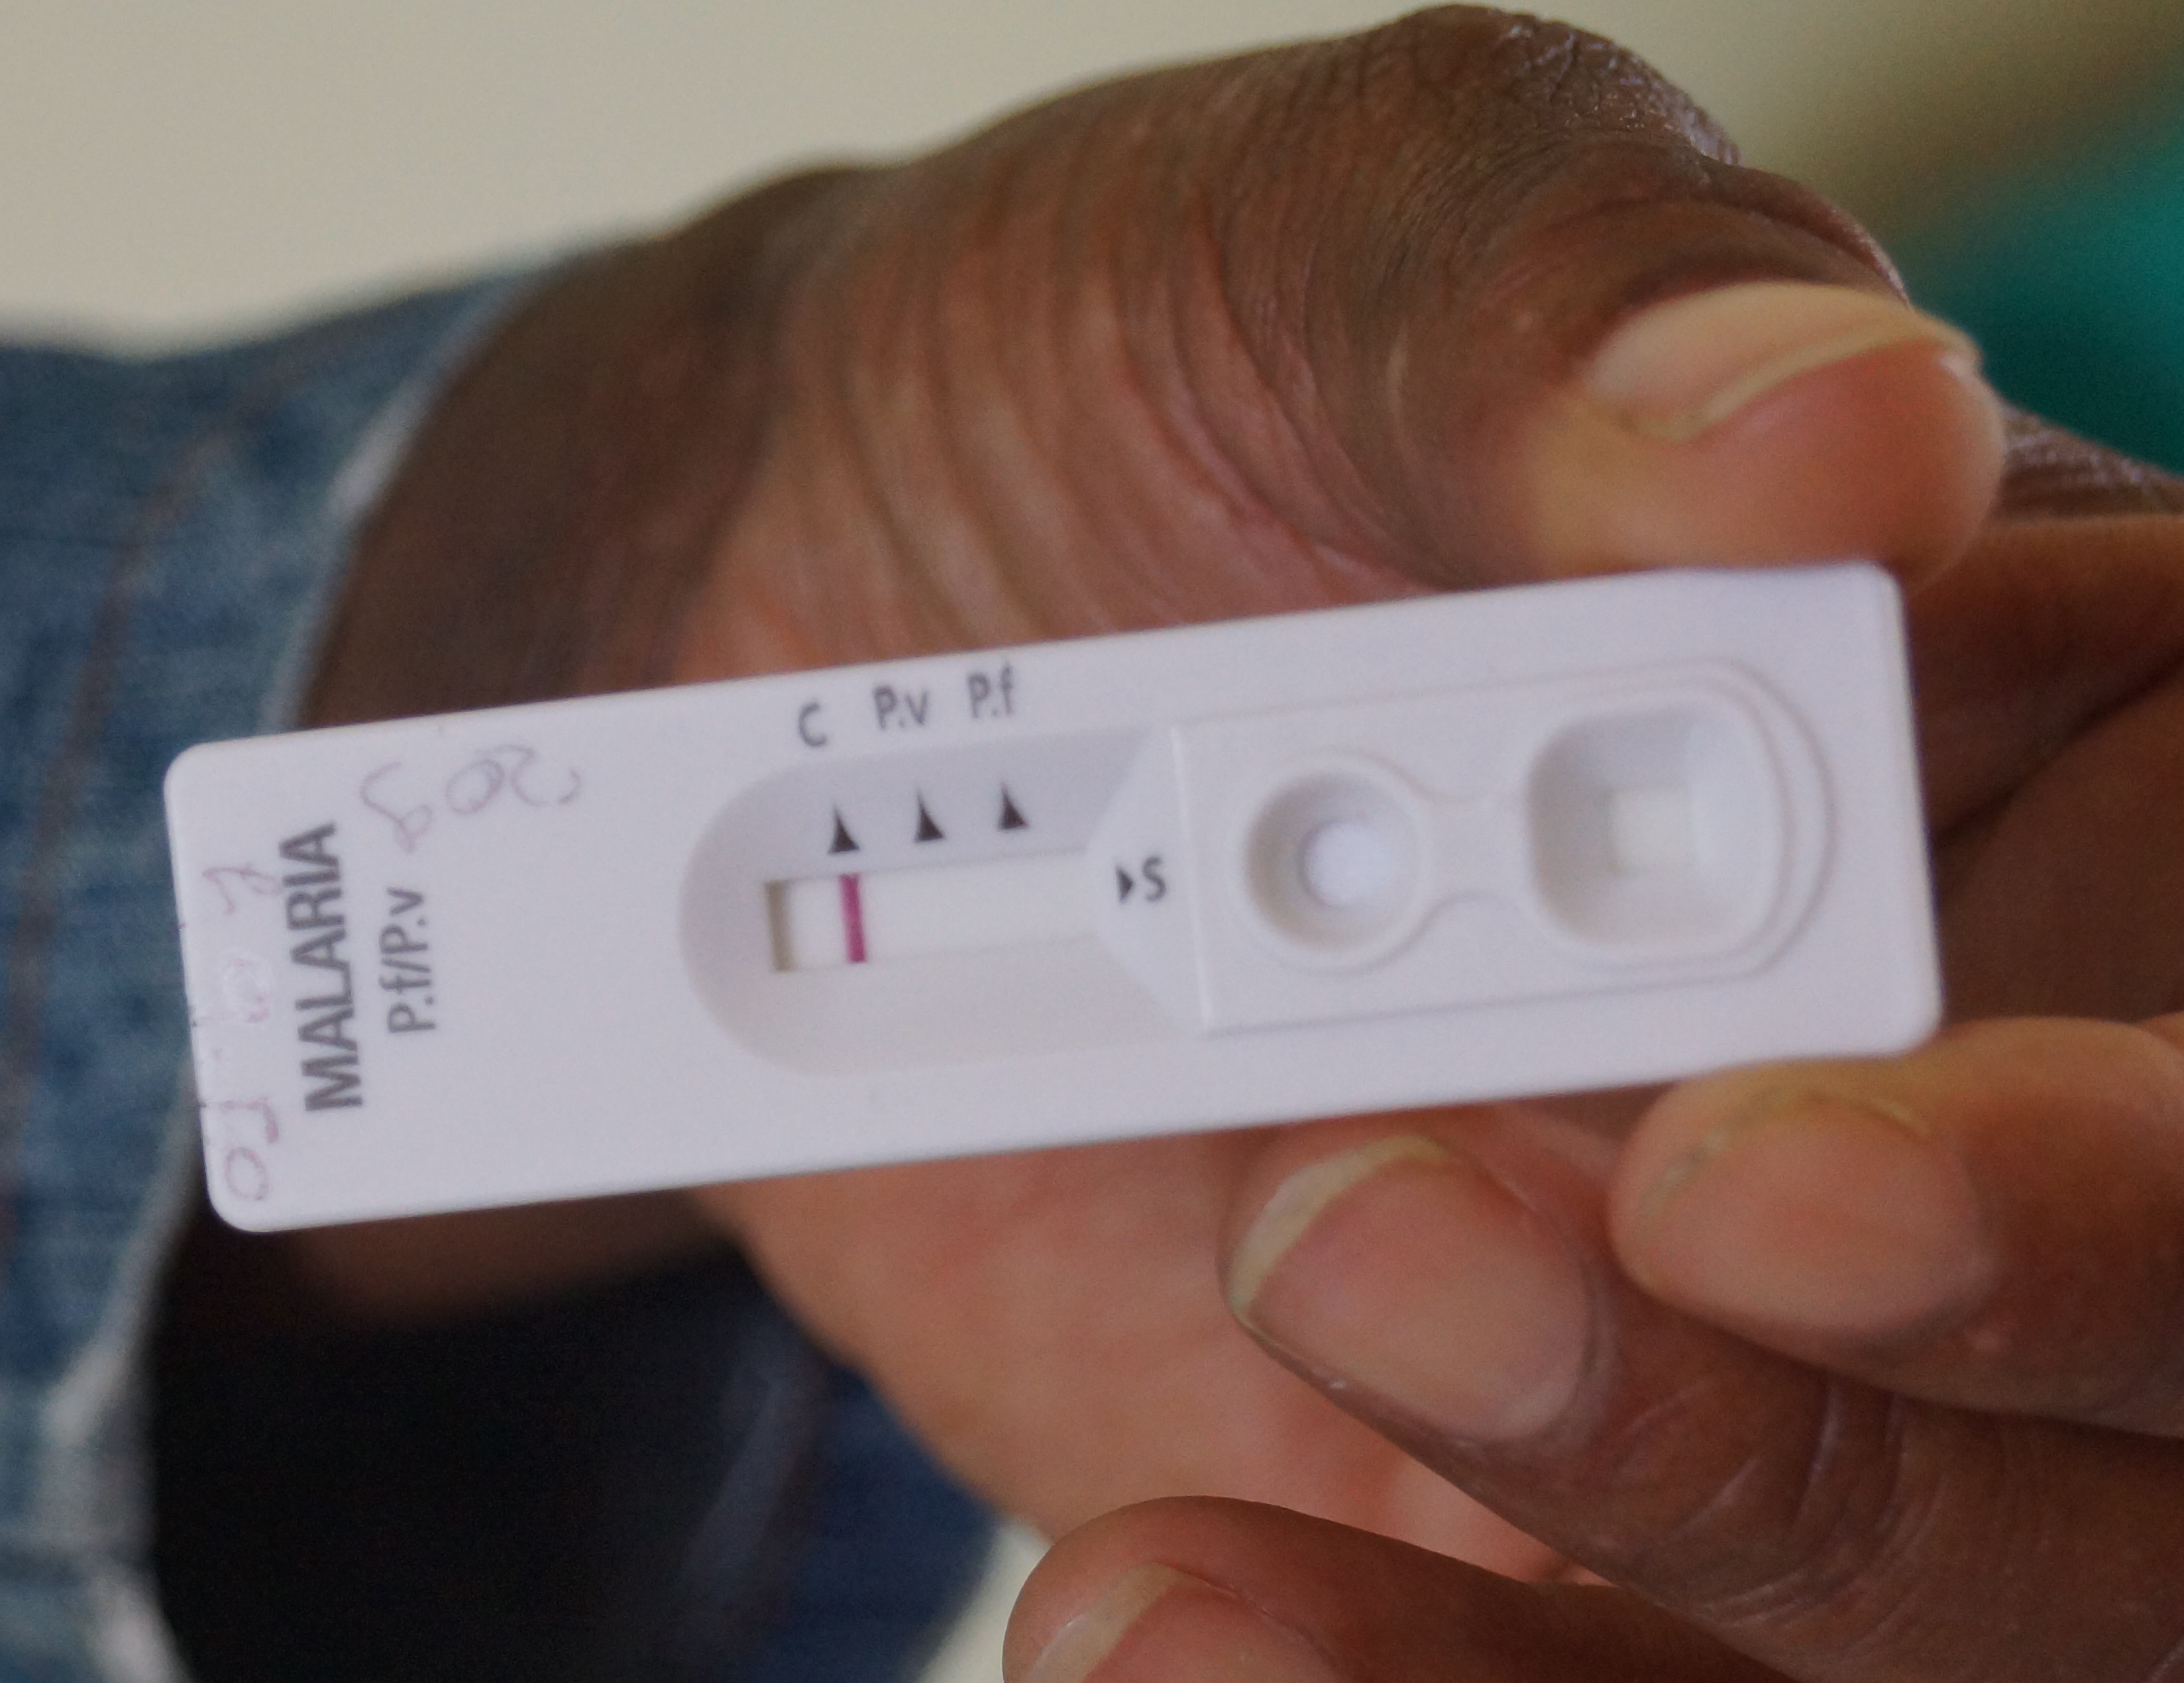
Malaria Diagnostics
hrp2
World Health Organization
Notes:
Add what a hmm is simply

Slide 8
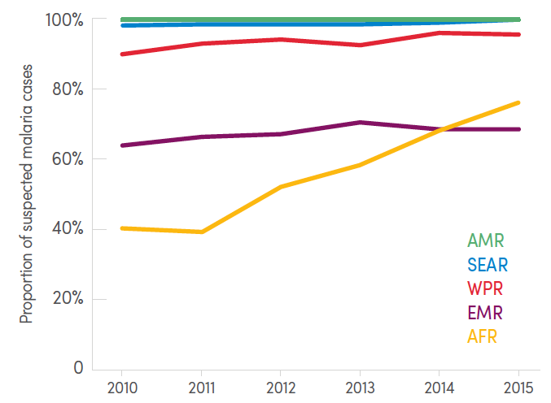
Uptake of RDTs
Proportion of suspected malaria cases attending public health facilities who receive a diagnostic test
Most target histidine-rich protein 2 (hrp2), a falciparum-specific antigen
WHO: use hrp2 in Africa
Enormous investment to provide RDTs to malaria endemic countries
Slide adapted from Jonathan Parr; Photo USAID (public domain)

Slide 9
Evolutionary Arms Race: Drug Resistance
Antimalarial Drug | Year Introduced | First Reported Resistance | Difference (years)
Quinine | 1632 | 1910 | 278
Chloroquine | 1945 | 1957 | 12
Proguanil | 1948 | 1949 | 1
Fansidar | 1967 | 1967 | 0
Mefloquine | 1977 | 1982 | 5
Atovaquone | 1996 | 1996 | 0
Artemisinin | 1980 | 2009 | 29
But diagnostic resistance, really?
Slide adapted from Steve Meshnick

Slide 10
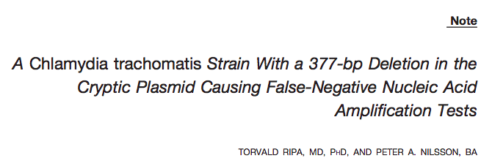
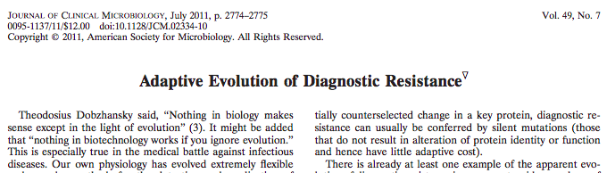
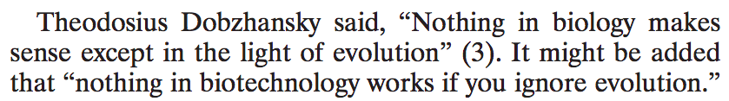
Evolutionary Arms Race: Diagnostic Resistance
“False Negatives”
Sex Trans Dis 2007, Metzgar D, J Clin Micro 2011.
Slide adapted from Jonathan Parr
Notes:
PMID: 17483723
Sweden began using Ct NAATs in the mid-1990’s
They noticed a sudden drop in cases by 25% in 2006
Investigation revealed a clonal strain with a 377bp deletion at the target of the NAAT

Slide 11
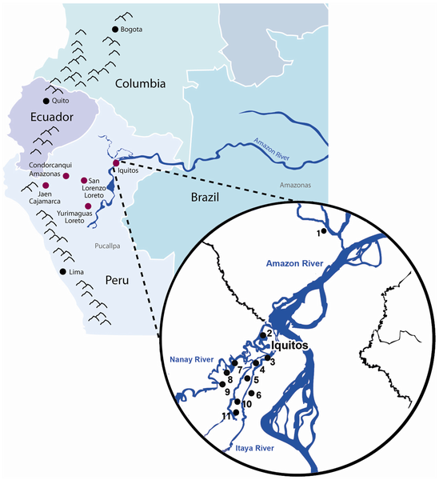
hrp2 Deletions Debut
First: Peruvian Amazon (2010)
148 stored samples from 2003-07
41% pfhrp2-deleted
70% pfhrp3-deleted
9 samples from Iquitos
89% pfhrp2-deleted
Later:
Reported in Colombia, Mali, Senegal, India, China
Small numbers tested, with 0-2% prevalence
Cheng et al. Malar J 2014. Figure from Gamboa D et al. PLoS ONE 2010, 5(1): e8091.
Slide adapted from Jonathan Parr
Notes:
Add what a hmm is simply

Slide 12


Your Scenario
EIS Officer in the Malaria Branch
Contacted by a concerned ministry of health official from a Sub-Saharan Africa country reporting RDT-negative malaria patients
Wants to know where hrp2 deletions are mostly likely to occur
Notes:
Add what a hmm is simply

Slide 13
Nuanced Points Relevant to Malaria Biology/Epidemiology
Notes:
Add what a hmm is simply

Slide 14

Multiplicity of Infection & hrp2
Superinfection
Why would we predict low transmission areas to have more hrp2 deletions?
Red is hrp2 deleted strain, yellow is wildtype
RDT -
RDT +
Notes:
Add what a hmm is simply

Slide 15
hrp2 as a Virulence Factor
The hrp2 gene has been implicated in severe clinical manifestations of malaria (e.g. “Severe Malaria”) and most commonly Cerebral Malaria
Loss of hrp2 may result in an attenuated strain that is more likely to be asymptomatic (hypothesized)
Why would this matter?
What is your differential diagnosis for Febrile Illness in SSA?
Pal et al. 2016; Park et al. 2017
Notes:
Add what a hmm is simply

Slide 16
The Asymptomatic Reservoir
Symptomatic Infection
Infectious to Mosquito
Asymptomatic, Patent Infection
Asymptomatic, Sub-patent Infection
True Negative
Remember, in our ”modeled” world, asymptomatic individuals do not seek treatment
(and parasites are free to be transmitted until the immune system wipes them out over time)

Slide 17
Let’s do some R coding
NOTE, please excuse any typos.
Exercise available at: https://github.com/nickbrazeau/EMSI2019hrp2lab

Slide 18
ouR Code Chunk
hrp2malaRia::hrp2_Simulation(
N=2000, # Population Size (number of individuals to simulate)
years=20, # Number of years to consider
microscopy.use = 0, # Proportion of cases tested by microscopy
EIR=1/365, # Number of (expected) infectious bites per year (e.g. transmission intensity)
ft=0.5, # Proportion of cases that seek treatment
fitness = 1, # Relative fitness of hrp2-deleted strains versus WT
strains.0 = 10, # Relative proportion of hrp2-deleted strains in population
rdt.nonadherence = 0, # Turn off for this exercise. (Proportion of negative RDTs due to hrp2 deletions that will still be treated)
rdt.det = 0 # Turn off for this exercise. (Proportion of positive RDTs due to hrp3 cross-reactivity)
)
Notes:
Add what a hmm is simply

Slide 19
Our “Real-Life” Scenario and Results/Conclusions
Notes:
Add what a hmm is simply

Slide 20
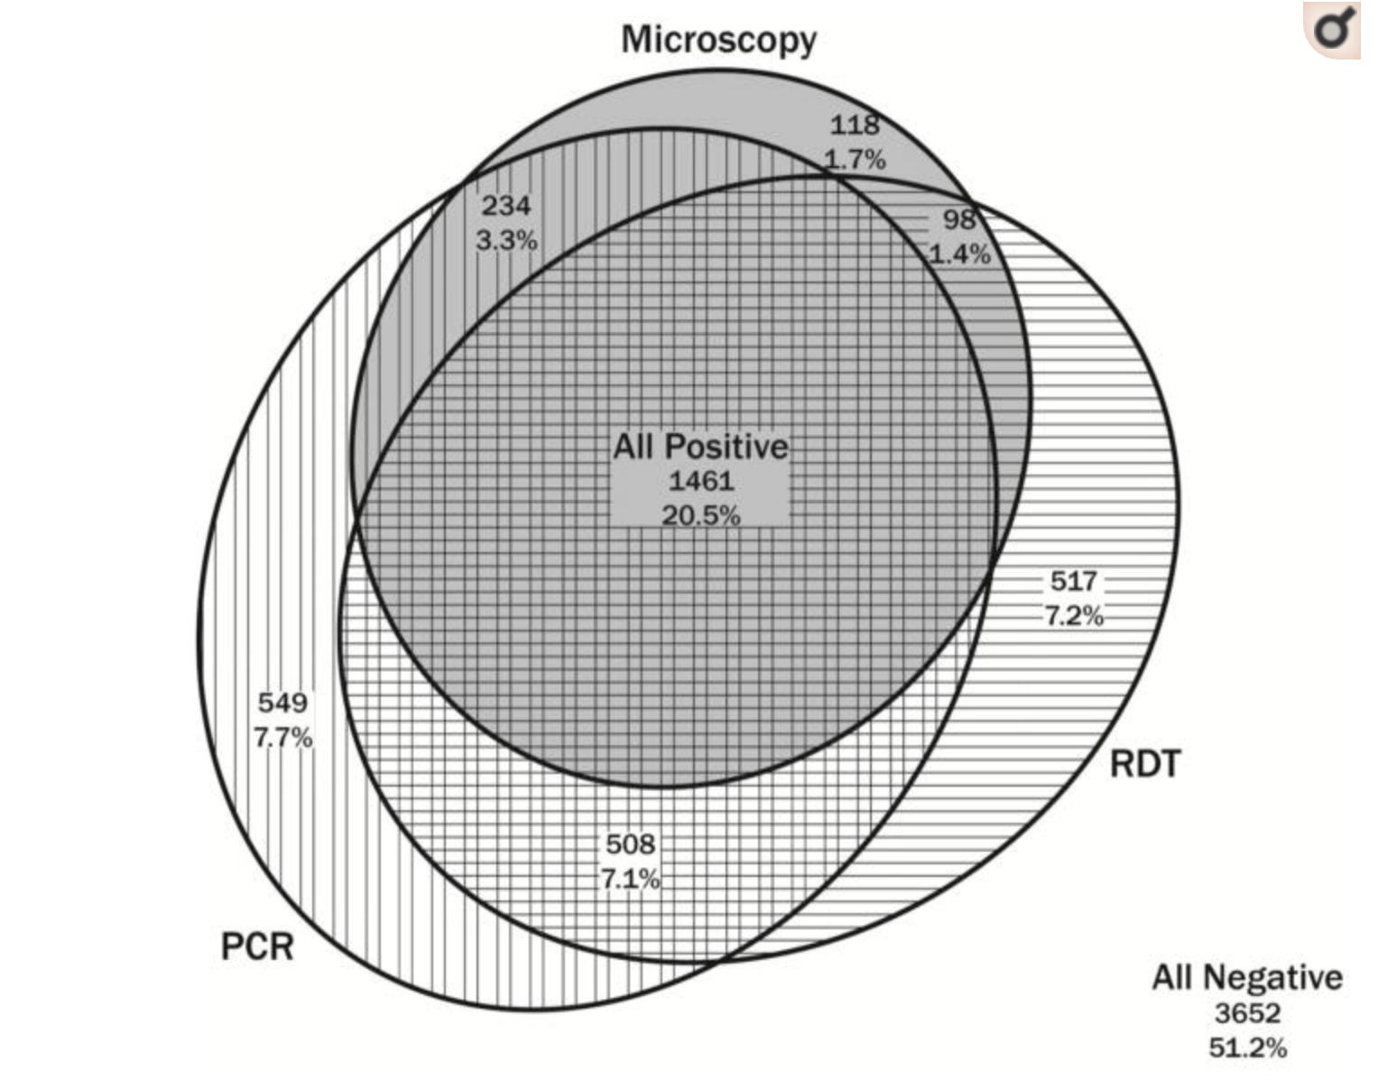
Surprising Observation
Odd?
Demographic Health Survey, Democratic Republic of the Congo (CD2013)
Nationally representative study
Doctor et al. 2016
Notes:
Add what a hmm is simply

Slide 21
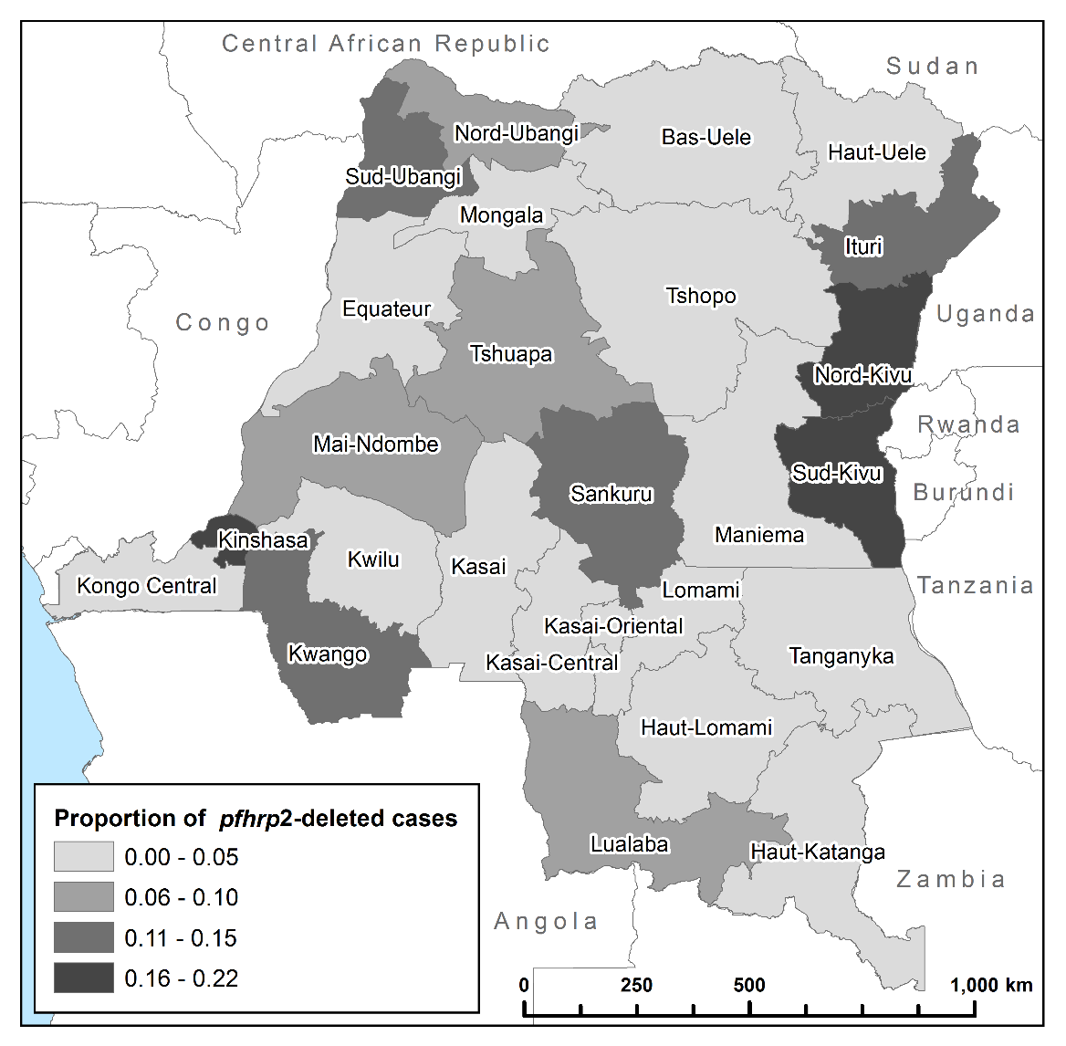
hrp2 Deletions in the DRC
First national survey
6.4% (n=149) prevalence among asymptomatic, PCR-pos subjects had a pfhrp2 deletion.
Only 5 (3.4%) of these 149 also had a pfhrp3 deletion
Spatial Clustering
Deletions more common in areas of low malaria prevalence (e.g. 21.9% in Kinshasa)
Figures from Gamboa D et al. PLoS ONE 2010; Parr et al. JID 2017, Watson et al. Elife 2017.
Slide adapted from Jonathan Parr
Notes:
Add what a hmm is simply

Slide 22

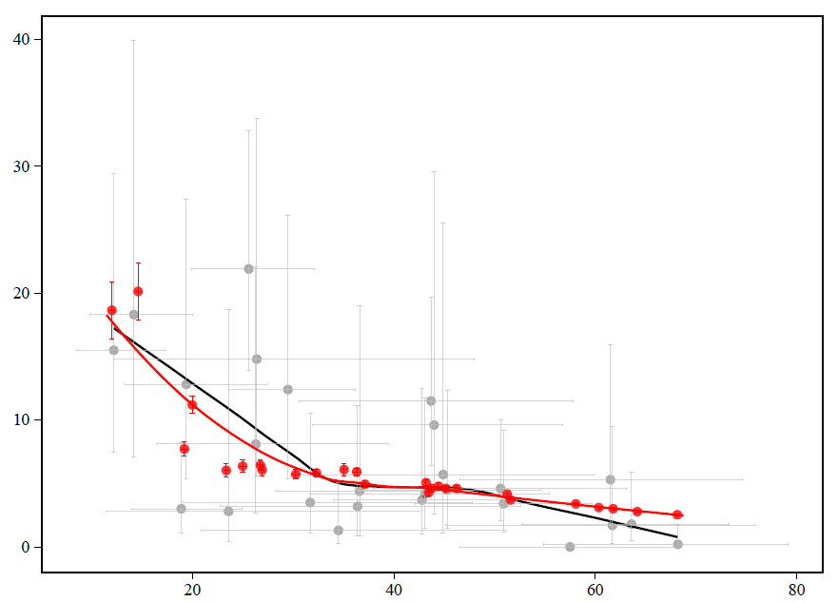
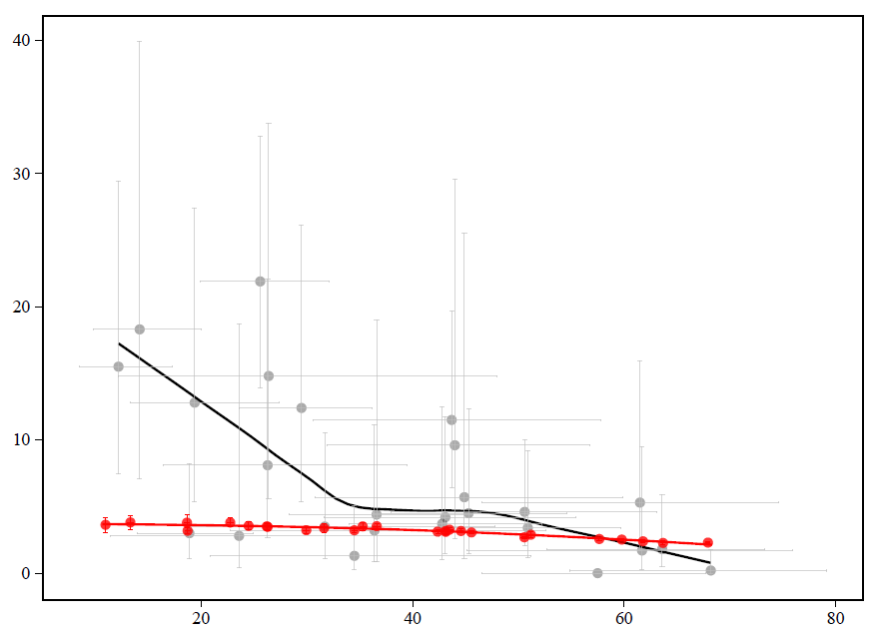

Deletion pattern by transmission level
Significantly higher proportion of deleted samples in low transmission areas
Can only be explained by selection through RDT-guided treatment decisions
With selection
Without selection
North-Kivu
South-Kivu
North-Kivu
South-Kivu
Proportion of individuals infected with only pfhrp2-deleted parasites
DRC
Simulation
PCR Prevalence in children 6-59 months old
Slide courtesy of Oliver Watson (Watson OJ et al., ELife 2017)
Notes:
1 min

Slide 23
Modeling hrp2 Deletion Patterns in the DRC: Transmission Level
Significantly higher proportion of deleted samples in low transmission areas
Can only be explained by selection through RDT-guided treatment decisions
With selection
Without selection
North-Kivu
South-Kivu
North-Kivu
South-Kivu
Proportion of individuals infected with only pfhrp2-deleted parasites
DRC
Simulation
PCR Prevalence in children 6-59 months old
Slide adapted from Jonathan Parr
Notes:
Add what a hmm is simply

Slide 24
Mapping Selection Pressure for pfhrp2-deletions
Prevalence in children 2-10 years old
Proportion of people seeking treatment
Slide courtesy of Oliver Watson (Watson OJ et al., ELife 2017)
Notes:
10s

Slide 25
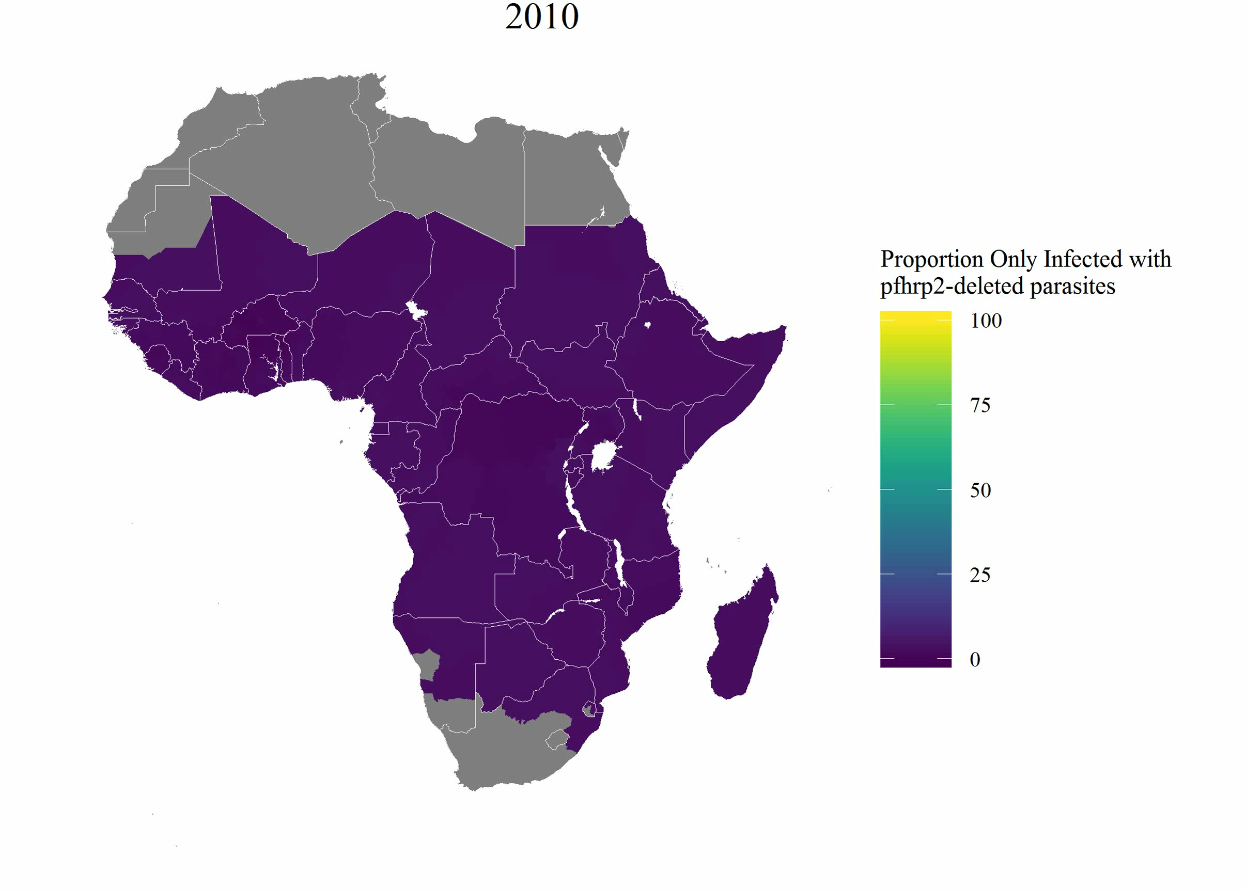
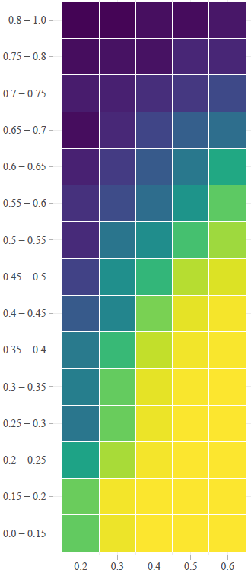
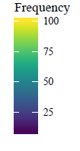
Modeling Selection-Drive Spread
Frequency of strains that are pfhrp2-deleted
Proportion of population
only infected with
pfhrp2-deleted parasites
Prevalence of Malaria
Proportion of people
seeking treatment
* Model assumes no change in prevalence and treatment coverage – spread therefore conservative
Slide courtesy of Oliver Watson & Jonathan Parr (Watson OJ et al., ELife 2017)
Notes:
40s

Slide 26
Modeling Conclusions
An increased emergence of pfhrp2-deleted mutants can be explained by the introduction of testing by PfHRP2-based RDTs in the last 10 years.
The use of these RDTs will result in the greatest selection pressure in regions that have low malaria transmission and a high frequency of people seeking treatment.
Need for further genetic investigations in the regions identified as having a high HRP2 concern.
Slide courtesy of Oliver Watson & Jonathan Parr (Watson OJ et al., ELife 2017)
Notes:
40s

Slide 27



Acknowledgements
Identification of hrp2 deleted parasites in the DRC
JID 2017
hrp2malaRia package
Elife 2017, 2019
Notes:
Add what a hmm is simply

